Slide 1
Politecnico di Milano
Computer Music: Languages and Systems
A.Y. 2022/2023
HW1 – Assignment #4
GRANULAR SYNTHESIS FOR FOLEY SOUNDS
Group #11 – Power Rangers
Emma Coletta
Federico Ferreri
Lorenzo Previati

Slide 2
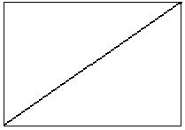
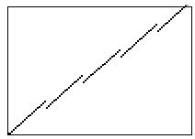
Granular Synthesis – a brief introduction
Original Sample
Sample after Granular Synthesis
Granular Synthesis: sound manipulation technique that uses audio fragments, called grains, to generate new sounds and patterns;
The rapid succession of the grains rebuilds the original sample, but it’s also possible to control some parameters, without changing the length of the output signal.
Grains: can last up to 100ms. Can be layered up and played at different speeds, phases, volume to create the resulting output;
Sound Envelope: describes how a sound changes over time and is characterized by attack, sustain and release time values. Allows to control the temporal overlap of the grains.

Slide 3
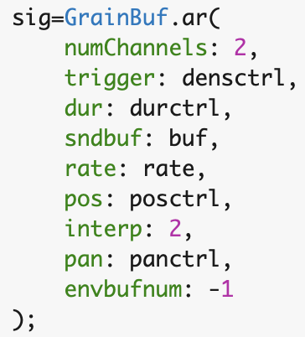
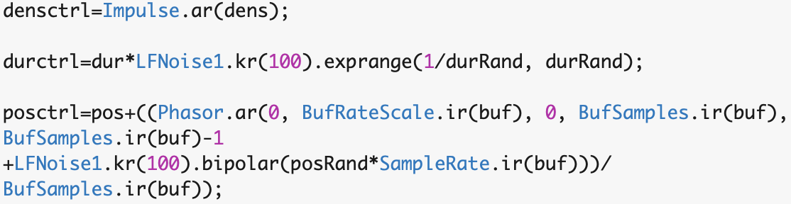
SuperCollider – implementation and code references
Implementation Steps:
Assignment of each sample to a buffer;
Synth Definition with parameters enriched by components of randomness;
GUI definition – creation of a graphical interface allowing the user to:
activate and deactivate the playback of a sound;
change grain parameters for the granular synthesis.
Buffer allocation function:
Buffer.readChannel(server, path, startFrame: 0, numFrames: -1, channels, action, bufnum);
Granular Synthesis
Synth Definition:
SynthDef.new to create a new synth;
Information on the envelope
Contains the granular synthesis function →
Allows the user to modify synthesis parameters for each buffer
GrainBuf.ar function:
works at audio rate;
requires the allocation of each audio sample to a buffer;
allows us to change a wide range of parameters (portion of code above)

Slide 4
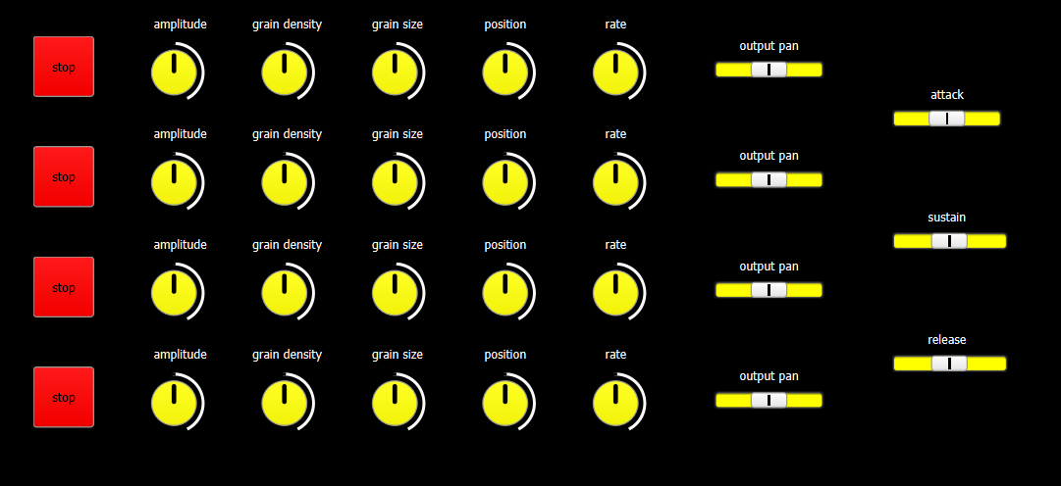
GUI – User Interface
Interface appearance
Editable synthesis parameters:
– Knobs
Amplitude
Grain Density
Grain Size
Playback Position
Rate
– Sliders
Pan
Output envelope time values
Amplitude: controls sound intensity
Grain Density:
Grain Size: duration of the grains;
Playback Position: decides the playback starting point of the audio;
Rate: playback rate of the samples sound;
Pan: panoramic diffusion of the output sound [between -1 and 1];

Slide 5
Conclusions
The output of our implementation is a modular ambient sound obtained through the granular synthesis of 4 different input tracks;
Real-time modulation of grain parameters allows us to create a complex sound from simpler ones;
The real human perception of sound is simulated through the introduction of components able to create unpredictability in the reproduction of grains

Slide 6

Thank You.

